Slide 1
MCBK Training Online Pilot Class December 28th Session: Systematic Reviews and Scoping Reviews
Dr. Feili Tu-Keefner
Feili Tu-Keefner, MLIS, PhD
(she/her/her)
(feilitu@sc.edu)
December 2021

Slide 2
Learning Objectives
Discuss what a systematic review and a scoping review are
1
Describe the procedures for conducting information retrieval, including selection of information systems and development of search strategies
2
Describe the processes to create these types of publications, including the discussion of PRISMA 2020 reporting guidelines
3

Slide 3
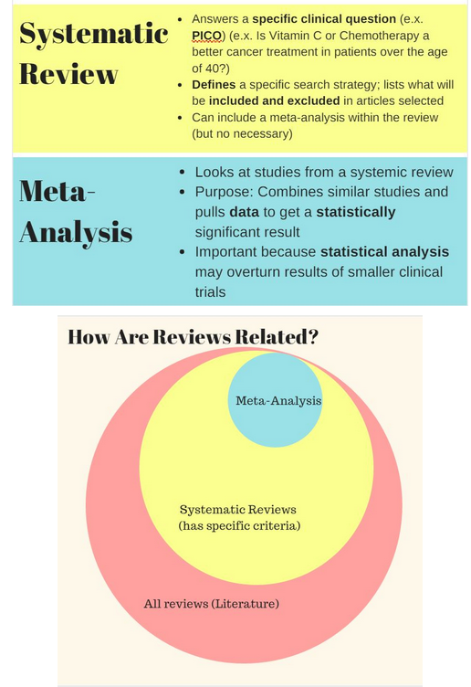
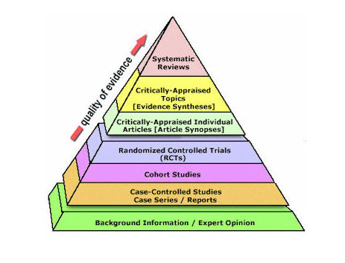
Levels of Evidence
EBM Pyramid and EBM Page Generator, copyright 2006 Trustees of Dartmouth College and Yale University. All Rights Reserved. Produced by Jan Glover, David Izzo, Karen Odato and Lei Wang.
https://libguides.uwf.edu/c.php?g=215131&p=5145952

Slide 4
Systematic Review Summarize the Current Best Evidence
Systematic Reviews:
Summarize the Current Best Evidence
Identify relevant studies
-- Information professionals have a definite role in the comprehensive identification of relevant studies needed for systematic reviews.
Apply rigorous methods for selection
Organize results
Provide a current answer to a specific question based on the best scientific evidence at the time
Mulrow, C. & Cook, D. (1998). Systematic review: Synthesis of best evidence for health care decisions. Philadelphia: American College of Physicians.

Slide 5
Meta-analysis: Methodology The Statistical Combination of Data Sets
Combines the results of similar research studies with identical or near-identical data sets to increase the statistical strength of the combined results
A meta-analysis relies on the compatibilities, or homogeneity, of the data sets.
Systematic reviews Meta-analyses
Not all the systematic reviews include meta-analyses.

Slide 6
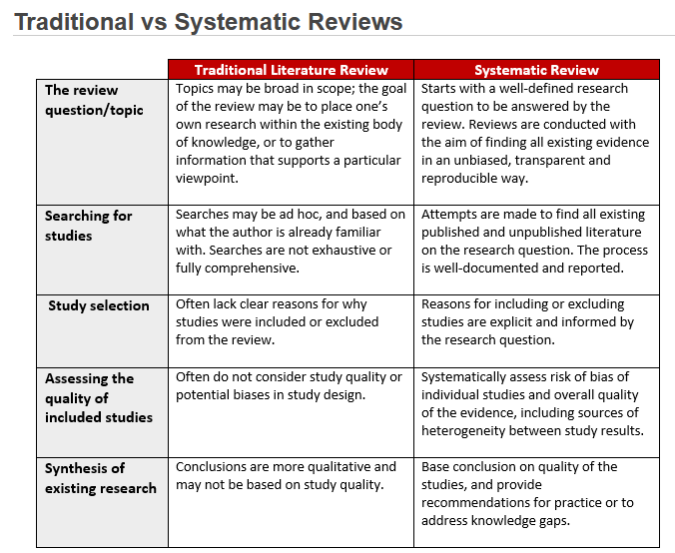
Traditional vs Systematic Reviews
Brown University Library. (2021, July
23). Scientific literature review
resources and services.
https://libguides.brown.edu/Reviews

Slide 7
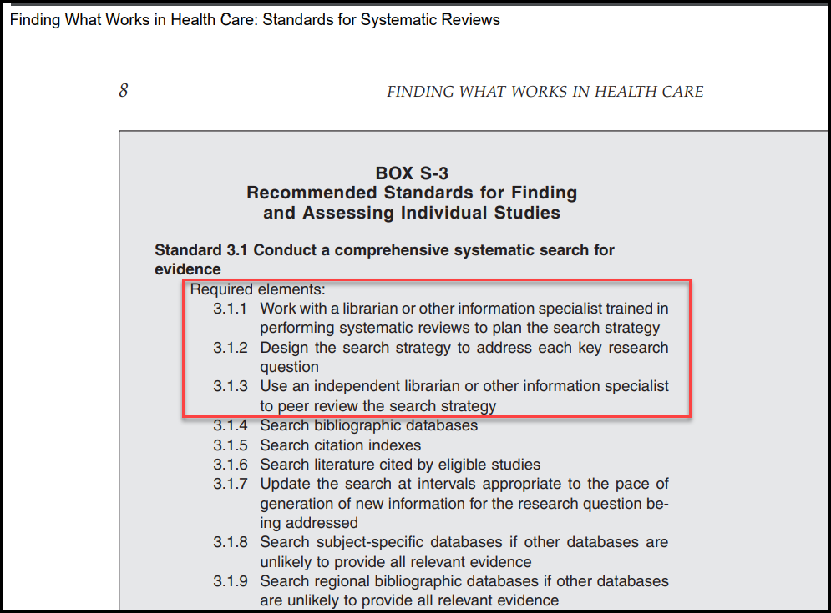
https://www.nap.edu/catalog/13059/finding-what-works-in-health-care-standards-for-systematic-reviews

Slide 8
Systematic Reviews:
the scope of the review is identified in advance
a comprehensive search is made to find all relevant studies
explicit criteria are used to include/exclude studies
established standards are applied to critically appraise study quality
explicit methods of extracting and synthesizing study findings as used (qualitative or quantitative)
May include a meta-analysis (quantitative synthesis)

Slide 9
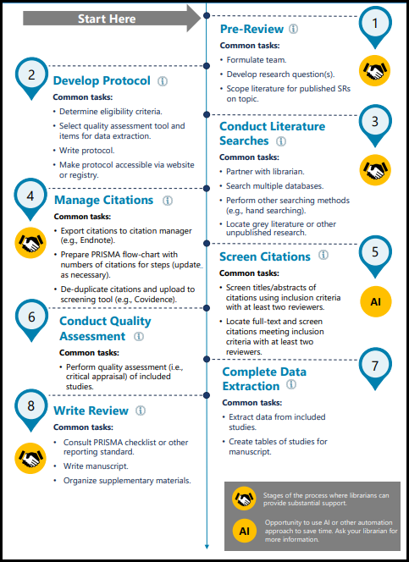
A protocol is a plan or set of steps to which a study will adhere.
The rationale for the review
The objectives of the review
The methods that will be used to locate, select, and critically appraise studies
The methods that will be used to analyze data from the included studies.
Development of a protocol is necessary because it promotes transparency, helps reduce the potential for bias, and serves to avoid unintended duplication of reviews.
https://guides.lib.unc.edu/systematic-reviews

Slide 10
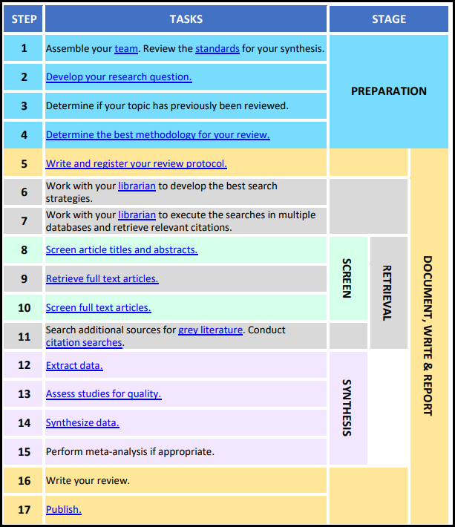
https://libraryguides.mayo.edu/systematicreviewprocess

Slide 11
Systematic Review: Limitations
Systematic reviews with narrowly defined review questions provide specific answers to specific questions.
Alternative questions that have not been answered usually need to be reconstructed by the reader.

Slide 12
Hazards of Quick Searches
A sound systematic review can be performed only if most or all of the available data are examined.
Complex and sensitive search strategies are needed to identify all possible studies
Some studies and/or clinical trials are published in journals not listed by PubMed/Medline.
Multiple sources must be used even though there are overlapping titles.
Compare the coverage of multiple sources
Compare the sizes of backfiles
Compare the policies to add new records to the databases
Data management:
Design a process to remove duplicate records

Slide 13
PICO Table
P (Problem or Patient or Population) | hospital acquired infection
I (intervention/indicator) | hand washing
C (comparison) | no hand washing; other solution; masks
O (outcome of interest) | reduced infection
What Type of question are you asking?
Type of Study you want to find

Slide 14
Does hand washing among healthcare workers reduce hospital acquired infections?
Natural Language | Subject Mapping
P (Problem/Patient/Population) =hospital acquired infection | cross infection [MeSH] cross infection [CINAHL]
I (intervention/indicator)=hand washing | hand disinfection [MeSH] handwashing [CINAHL]

Slide 15
PRISMA Guidelines: Planning a Systematic Review Project
Step 1: Why do a systematic review?
1
Step 2: Who will be involved?
2
Step 3: Formulate the problem.
3
Has it been done before? Registering your review.
Step 4: Perform your search.
4
Step 5: Data extraction.
5
Step 6: Critical appraisal of studies (quality assessment).
6
Step 7 Data synthesis.
7
Step 8: Presenting results (writing the report).
8
Step 9: Archiving and updating.

Slide 16
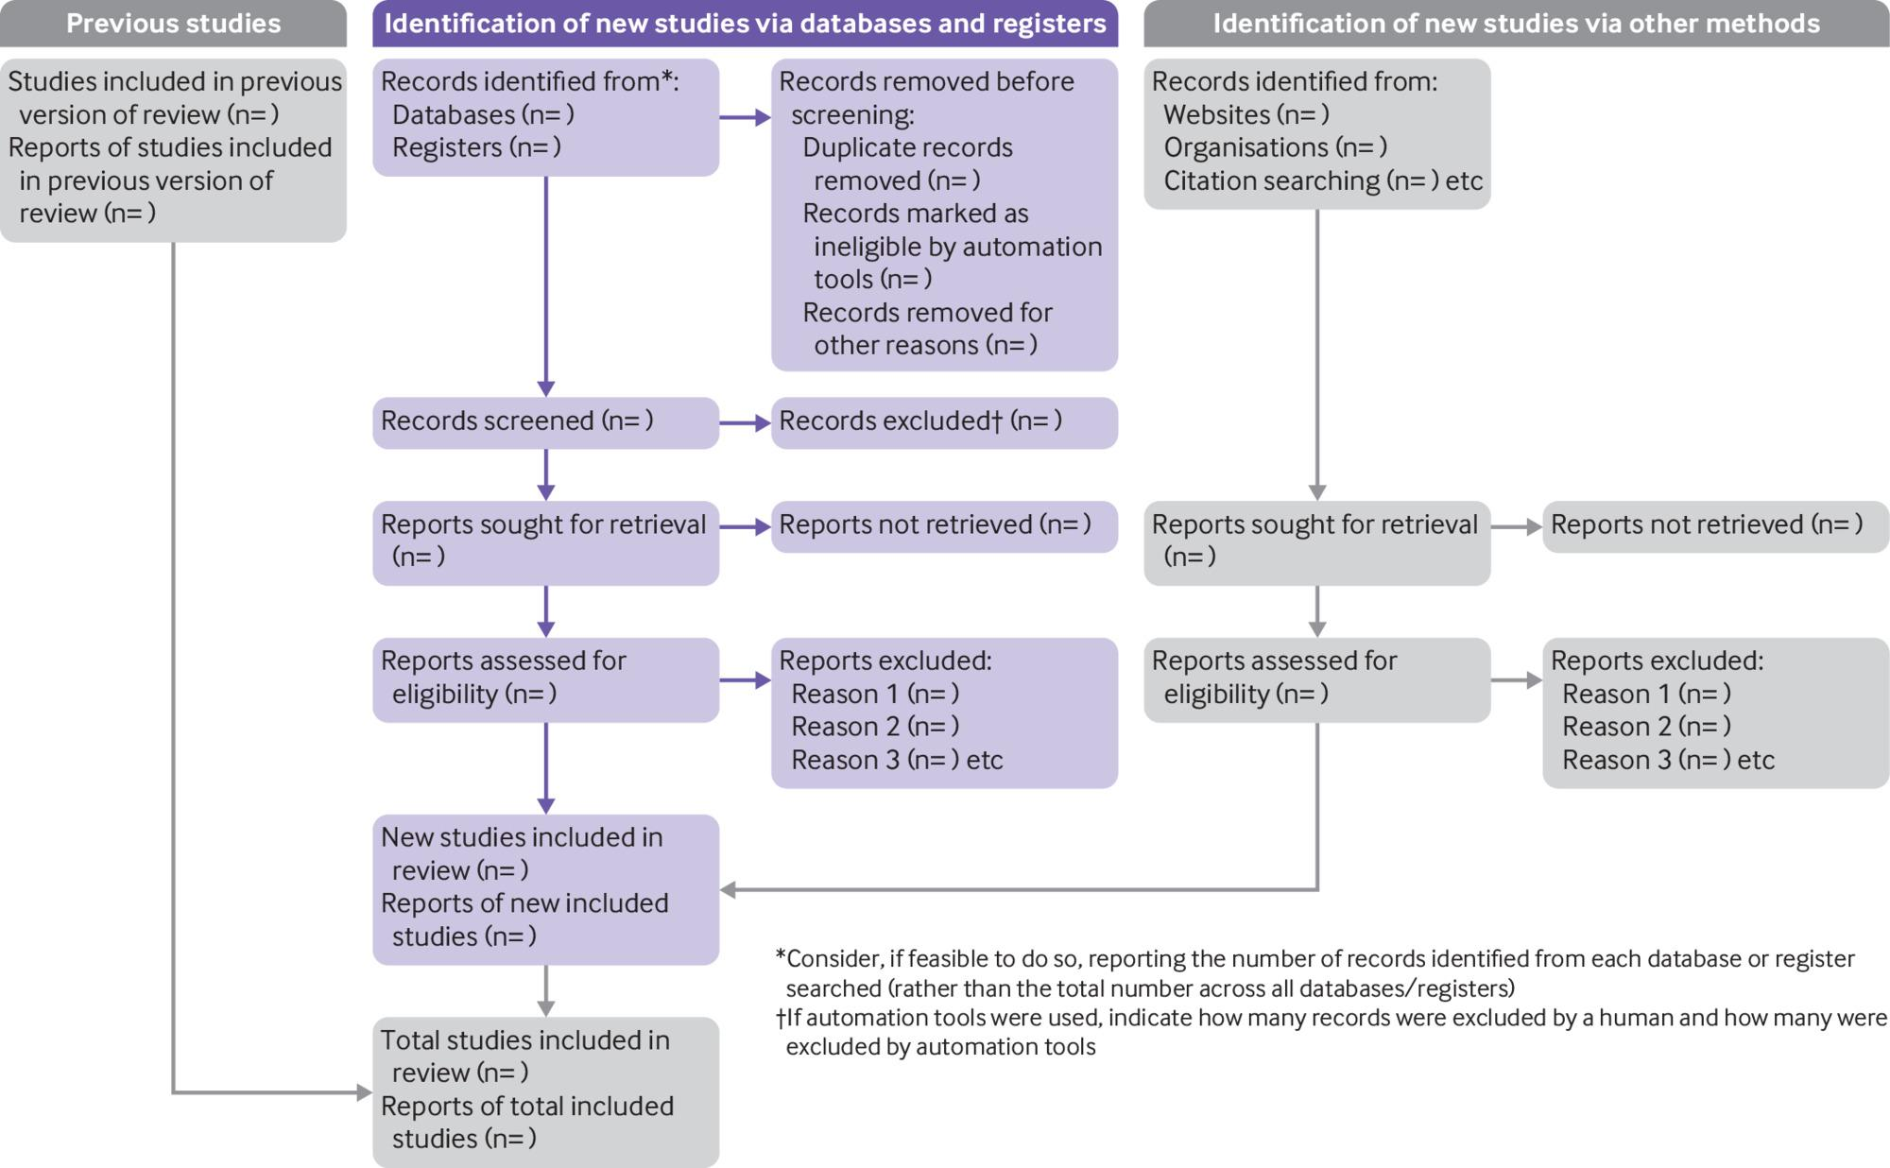
PRISMA 2020 flow diagram template for systematic reviews.
©2021 by British Medical Journal Publishing Group
Matthew J Page et al. BMJ 2021;372:bmj.n71
Notes:
PRISMA 2020 flow diagram template for systematic reviews. The new design is adapted from flow diagrams proposed by Boers,55 Mayo-Wilson et al.56 and Stovold et al.57 The boxes in grey should only be completed if applicable; otherwise they should be removed from the flow diagram. Note that a “report” could be a journal article, preprint, conference abstract, study register entry, clinical study report, dissertation, unpublished manuscript, government report or any other document providing relevant information.

Slide 17
https://www.campbellcollaboration.org/
http://www.prisma-statement.org/
https://www.crd.york.ac.uk/prospero/
https://www.equator-network.org/

Slide 18
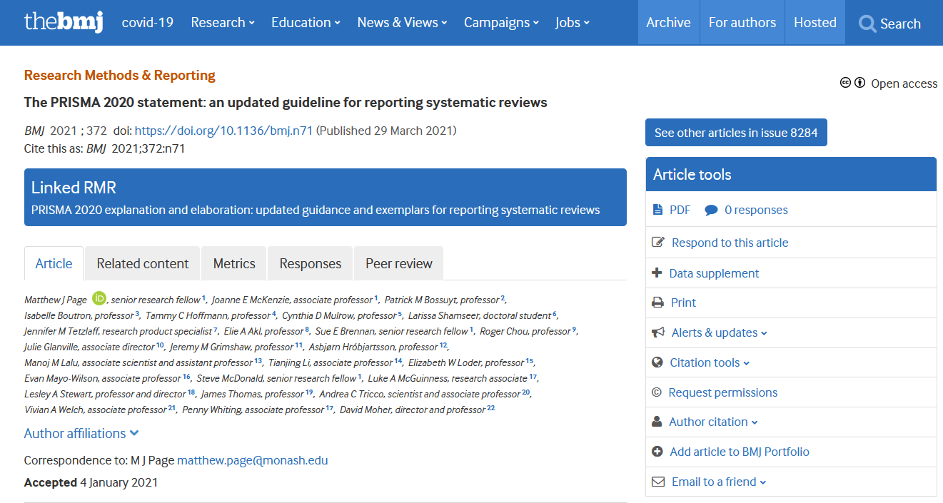
https://www.bmj.com/content/372/bmj.n71

Slide 19
What is a Scope Review?
Scoping reviews have great utility for synthesizing research evidence and are often used to [categorize or group] existing literature in a given field in terms of its nature, features, and volume.
Scoping reviews are preliminary assessment of potential size and scope of available research literature. They aim to identify nature and extent of research evidence (usually including ongoing research).

Slide 20
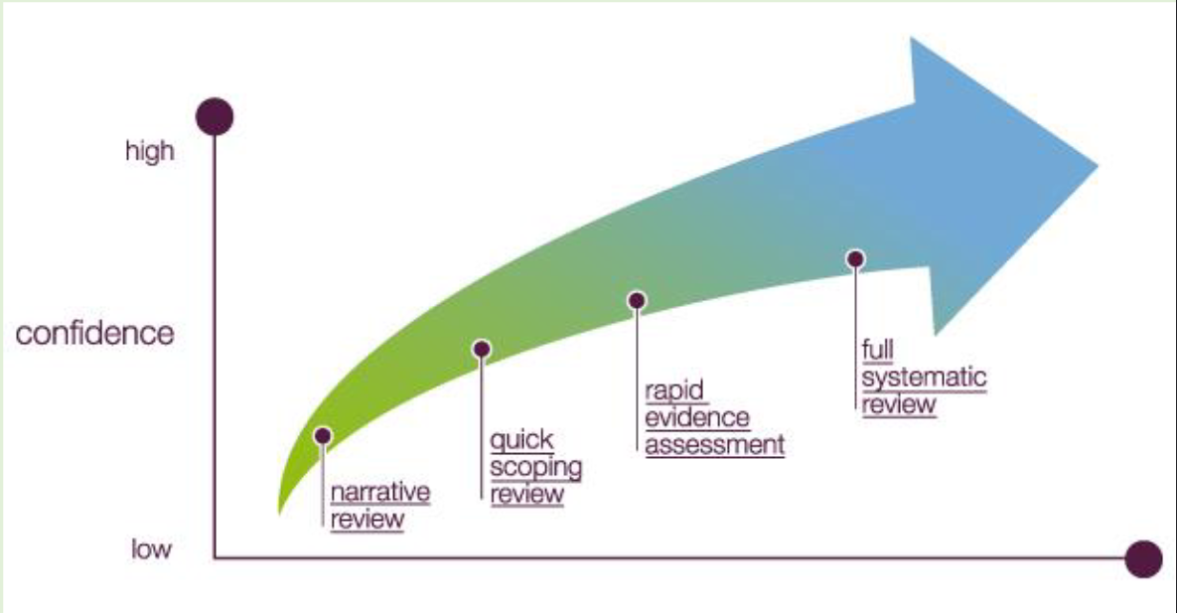
Peters, M. D., Godfrey, C. M., Khalil, H., McInerney, P., Parker, D., & Soares, C. B. (2015). Guidance for conducting systematic scoping
reviews. International Journal of Evidence-based Healthcare, 13, 141-146. https://doi.org/10.1097/XEB.0000000000000050

Slide 21
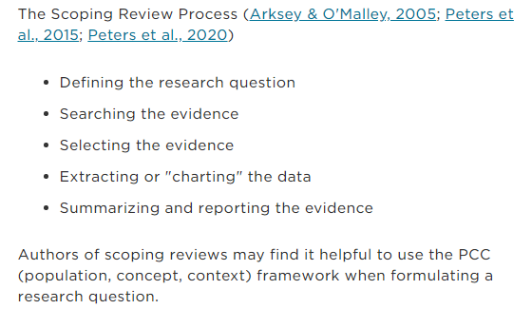
Scoping Review
A Scoping Review is exploratory in nature and answers a broad research question designed to assess the extent of the existing research.
Characteristics:
maps the extent of research conducted on a topic (often a broad topic)
includes data from any type of evidence and research methodology
determines if a full systematic review is warranted
can also be used as a standalone project
summarizes the existing research
Identifies gaps in the research
Arksey, H., & O'Malley, L. (2005). Scoping Studies: Towards a methodological framework. International Journal of Social Research
Methodology, 8(1), 19-32. https://doi.org/10.1080/1364557032000119616

Slide 22
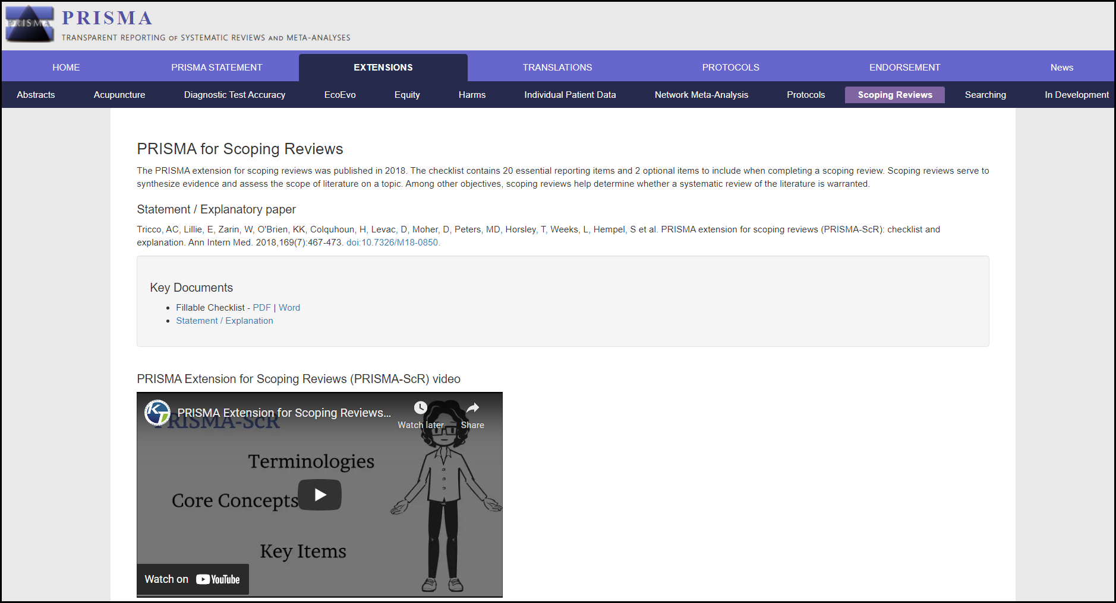
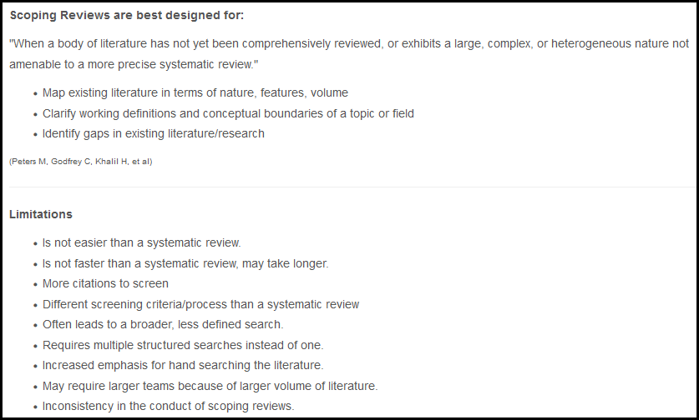
https://libraryguides.missouri.edu/c.php?g=28397&p=6022220
http://www.prisma-statement.org/Extensions/ScopingReviews

Slide 23
https://training.cochrane.org/resource/scoping-reviews-what-they-are-and-how-you-can-do-them

Slide 24
Publication Type | Example
Research Report | Lewin, M. H., Bailey, N, Bandaletova, T., Bowman, R., Cross, A. J, Pollock, J., Shuker, D. E., & Bingham, S. A. (2006). Red meat enhances the colonic formation of the DNA adduct O6-carboxymethyl guanine: Implications for colorectal cancer risk. Cancer Research, 66(3), 1859-1865. https://doi.org/10.1158/0008-5472.CAN-05-2237
Narrative Review | Fraser, G. E. (2009). Vegetarian diets: What do we know of their effects on common chronic diseases? American Journal of Clinical Nutrition, 89(5), 1607S-1612S. https://doi.org/10.3945/ajcn.2009.26736K
Scoping Review | Krick, T., Huter, K., Domhoff, D., Schmidt, A., Rothgang, H., & Wolf-Ostermann, K. (2019). Digital technology and nursing care: A scoping review on acceptance, effectiveness and efficiency studies of informal and formal care technologies. BMC Health Services Research, 19, 400. https://doi.org/10.1186/s12913-019-4238-3
Systematic Review | Streuling, I., Beyerlein, A., Rosenfeld, E., Schukat, B., von Kries, R. (2011). Weight gain and dietary intake during pregnancy in industrialized countries--A systematic review of observational studies. Journal of Perinatal Medicine, 39(2), 123-129. https://doi.org/10.1515/JPM.2010.127
Systematic Review with Meta-analysis | Abdalla, G., Fawzi Matuk, R., Venugopal, V., Verde, F., Magnuson, T. H., Schweitzer, M. A., Steele, K. E. (2015). The diagnostic accuracy of magnetic resonance venography in the detection of deep venous thrombosis: a systematic review and meta-analysis. Clinical Radiology, 70(8), 858-871. https://doi.org/10.1016/j.crad.2015.04.007

Slide 25
Discussion Topics
Please critique the following article:
https://www.acpjournals.org/doi/10.7326/0003-4819-157-5-201209040-00007?articleid=1355685
Following the “Standards for Systematic Reviews” on slide 7, please create a library service policy to ensure that librarians/health information professionals are listed as co-authors and/or receive credit for their work.
Please choose a topic and work together to create a scoping review protocol. In addition, please use the topic to develop the five stages of actions described on slide 21 to prepare a scoping review project.
Example: https://bmcmedresmethodol.biomedcentral.com/articles/10.1186/1471-2288-12-114

Slide 26
Comments
Contact Me:
Feili Tu-Keefner, MLIS, PhD (feilitu@sc.edu)

